Slide 1
Self Learning Tutorial
Early Detection of Acute Kidney Injury (AKI)
AI - 395T | AI in Healthcare | Dr. Ying Ding
By - Sharang Agarwal

Slide 2
Goal and Motivation
Problem Statement
Acute Kidney Injury (AKI) is a sudden decline in kidney function, often detected late leading to severe complications. Early detection using EHR and lab tests can improve patient outcomes.
Objective This study leverages MIMIC-III patient data to analyze serum creatinine (SCr) trends and detect AKI early using machine learning techniques.

Slide 3
Data Source and code
MIMIC-III Dataset
We use the MIMIC-III database, focusing on LABEVENTS and PATIENTS tables.
The key biomarker for AKI detection is Serum Creatinine (SCr).
Code can be found on github link:
https://github.com/sharangagarwal/msai_ai_healthcare/blob/main/Self_learning_tutorial.ipynb

Slide 4
Methodology
Our approach follows a structured pipeline to detect AKI early:
Data Extraction: Retrieve SCr values from MIMIC-III.
Preprocessing: Clean and merge patient and labevent records.
Feature Engineering: Compute SCr trends and define AKI criteria.
Model Training: Train ML models on historical patient data.
Evaluation: Assess models using accuracy, recall and AUC-ROC.

Slide 5
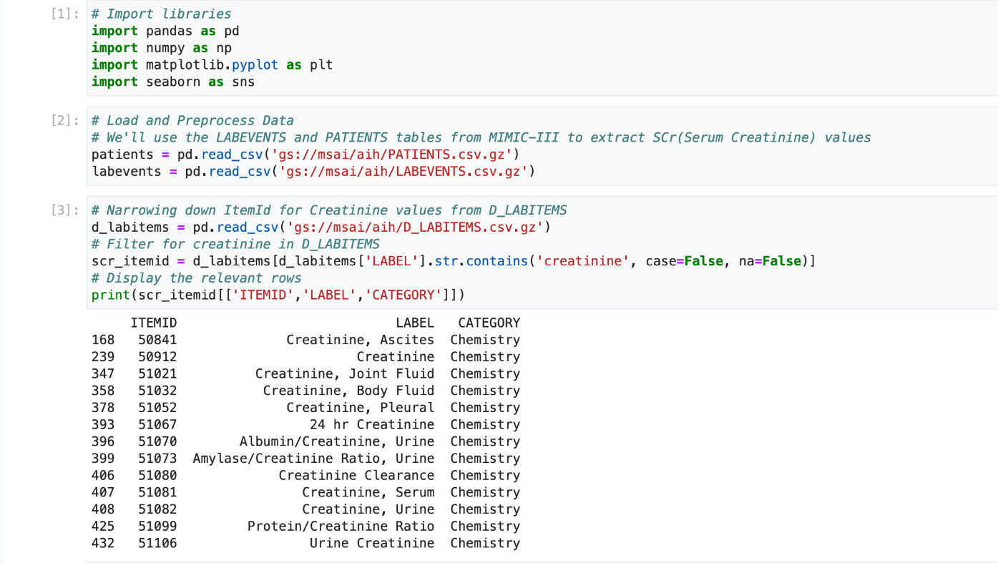
Step 1 : Import Data
We begin by importing patient and labevents data from the MIMIC-III database using Pandas. The LABEVENTS and PATIENTS tables are loaded, and relevant ITEMID are filtered based on ITEMIDs from D_LABITEMS table to focus on serum creatinine measurements.

Slide 6
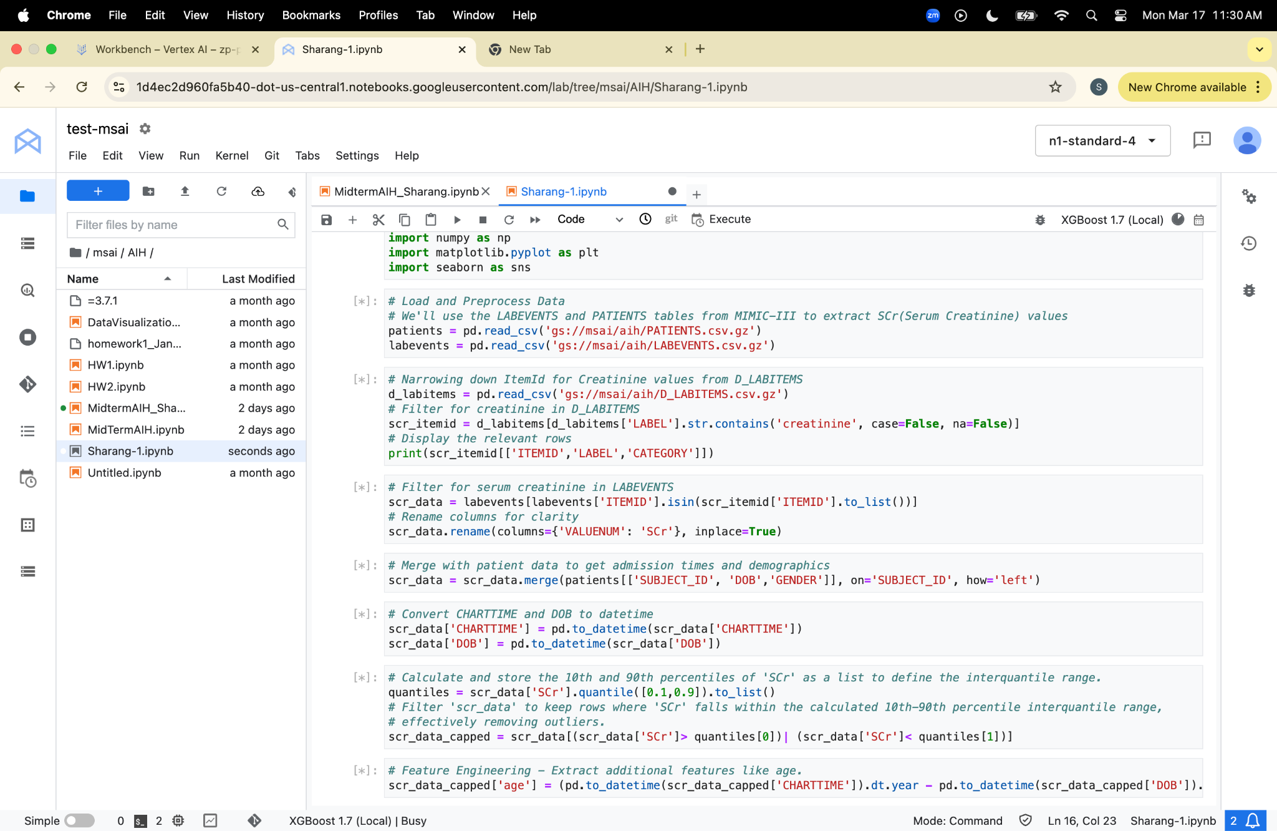
Step 2(a): Data Preprocessing
Using the D_LABITEMS ITEMIDs we filter out unrelated ITEMIDs from LABEVENTS. Finally, we merge this data with patient records to incorporate demographic details and admission information. To ensure accurate time-based analysis, Charttime and Date of Birth (DOB) are converted to datetime format.

Slide 7
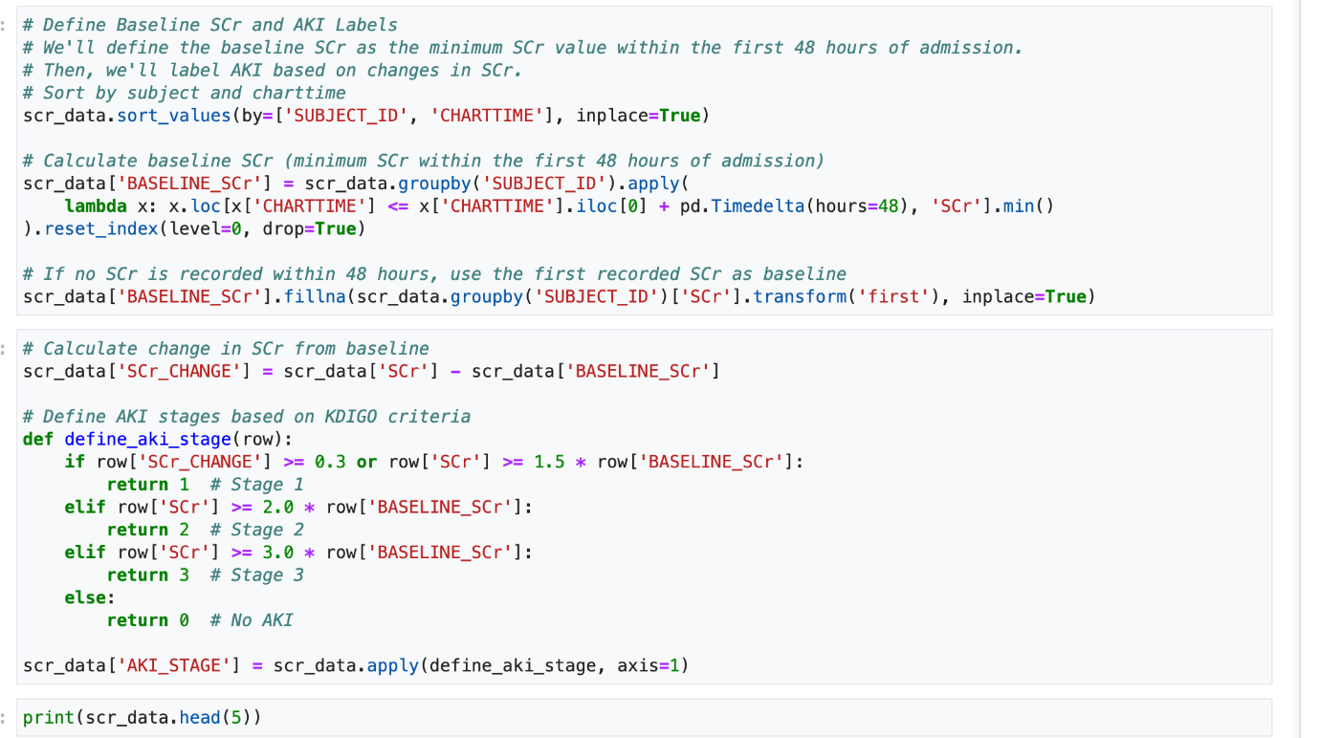
Step 2(b): AKI Definition
To identify AKI, we first establish a baseline serum creatinine (SCr) value, defined as the minimum SCr recorded within the first 48 hours of hospital admission. If no SCr measurement is available in this period, the first recorded SCr value is used as the baseline. We then compute the change in SCr from the baseline to track fluctuations. AKI stages are assigned based on KDIGO (Kidney Disease: Improving Global Outcomes) criteria, where Stage 1 is defined by an increase of at least 0.3 mg/dL or 1.5x the baseline SCr, Stage 2 occurs at 2x the baseline SCr, and Stage 3 at 3x the baseline SCr.

Slide 8
Step 2(c): Data Processing
Then we identify and remove outliers by computing the 10th and 90th percentiles of serum creatinine (SCr) values. Data points outside this interquartile range are filtered out. Additionally, we extract age as a new feature by calculating the difference between the year of chart time and date of birth.

Slide 9
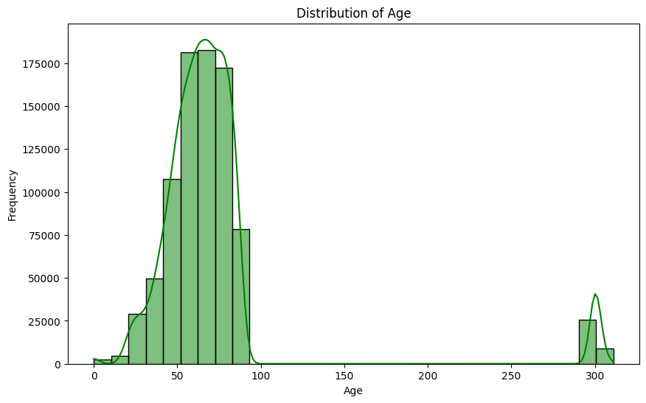
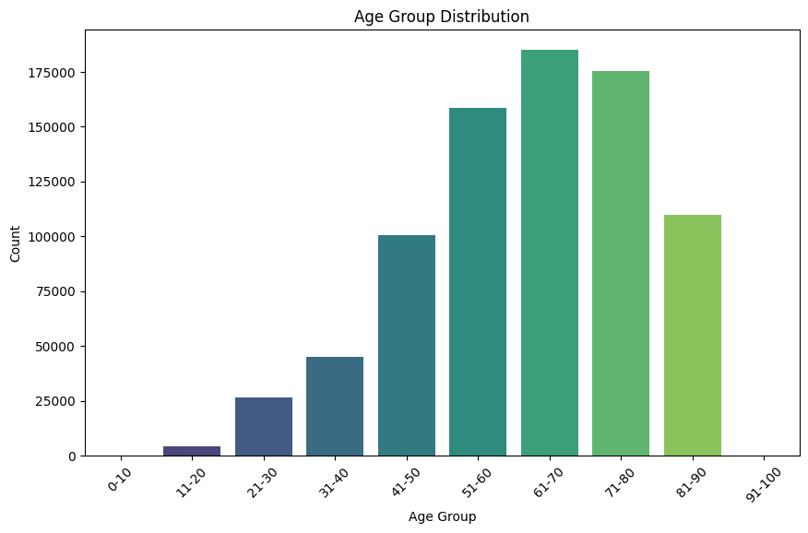
Step 3: Exploratory Data Analysis - visualization
We begin by analyzing the age distribution of patients using a histogram to get insights into the demographic structure of the dataset. To further explore trends, we categorize patients into age groups and visualize their distribution with a bar chart. Next, we examine the relationship between serum creatinine (SCr) levels and age. A line plot illustrates the average SCr level across different ages, while a scatter plot highlights individual variations in SCr by age. Additionally, we compare SCr levels across genders using a scatter plot and analyze age distribution by gender using a box plot.

Slide 10
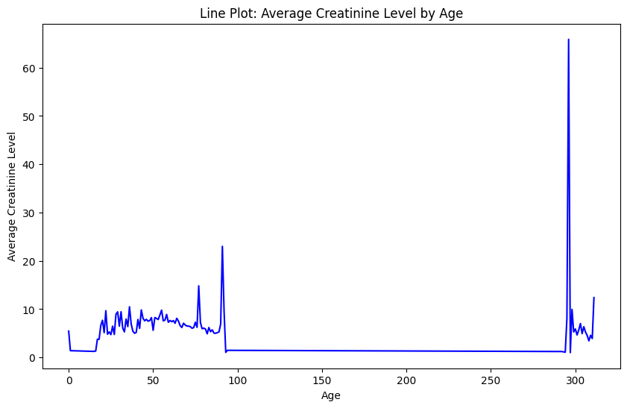
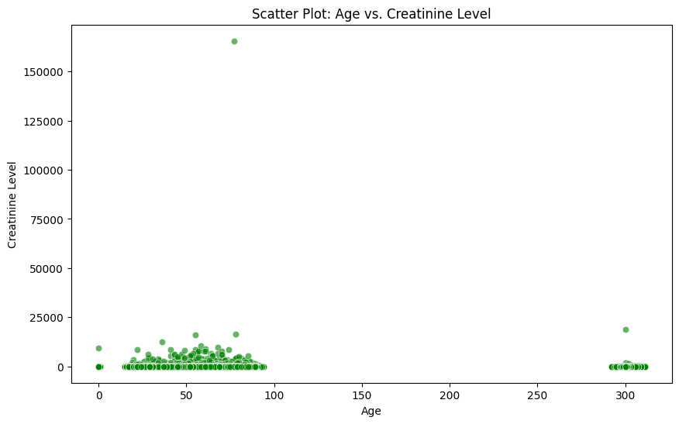
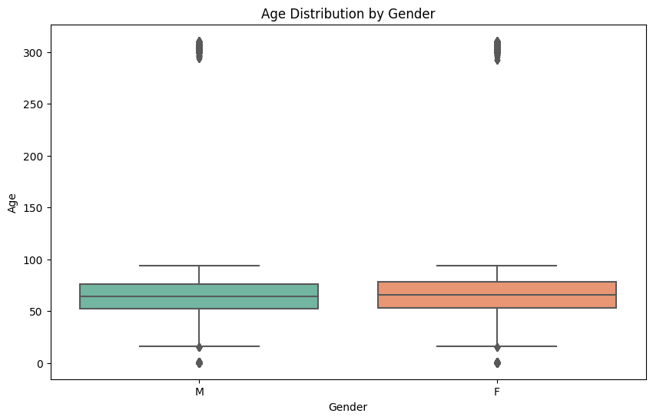

Slide 11
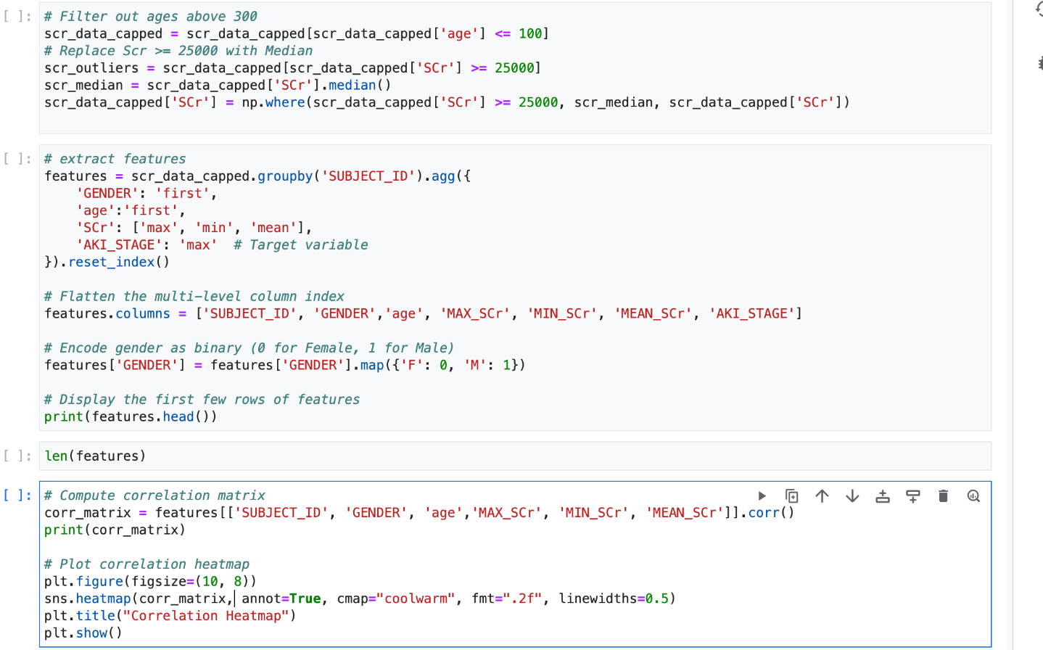
Step 4: Feature Engineering
After visualizing, I performed data cleaning by filtering out ages above 100 and replacing extreme SCr values (≥ 25,000) with the median to handle outliers. I then aggregated the data by SUBJECT_ID, capturing key statistics of SCr (max, min, mean), the first occurrence of GENDER, age and the maximum AKI_STAGE as the target variable. I encoded GENDER as binary and computed a correlation matrix for the numerical features.

Slide 12
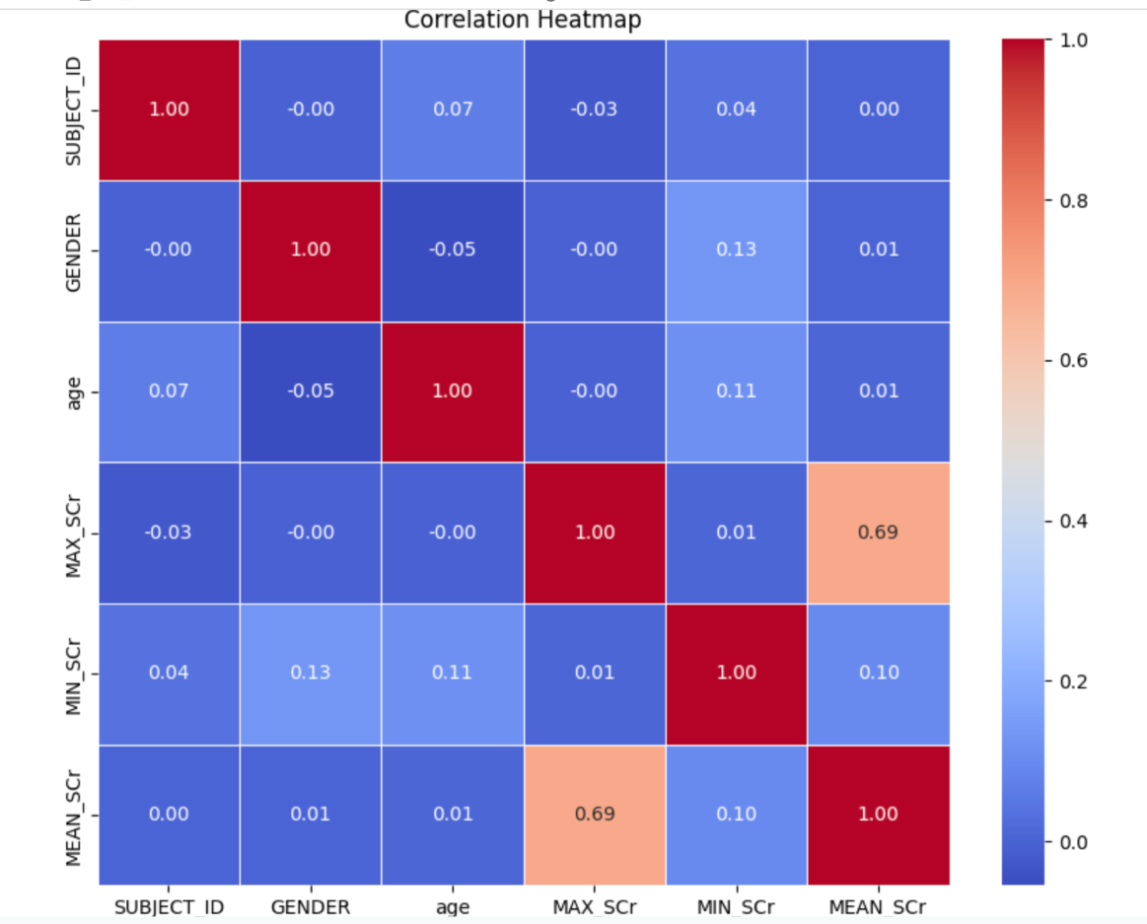
The correlation matrix reveals that MAX_SCr and MEAN_SCr are strongly correlated (0.69), indicating a strong relationship between the maximum and mean serum creatinine levels. GENDER shows a slight positive correlation with MIN_SCr (0.13), while AGE has a small positive correlation with MIN_SCr (0.11), suggesting older patients may have higher minimum creatinine levels. Other correlations are minimal.

Slide 13
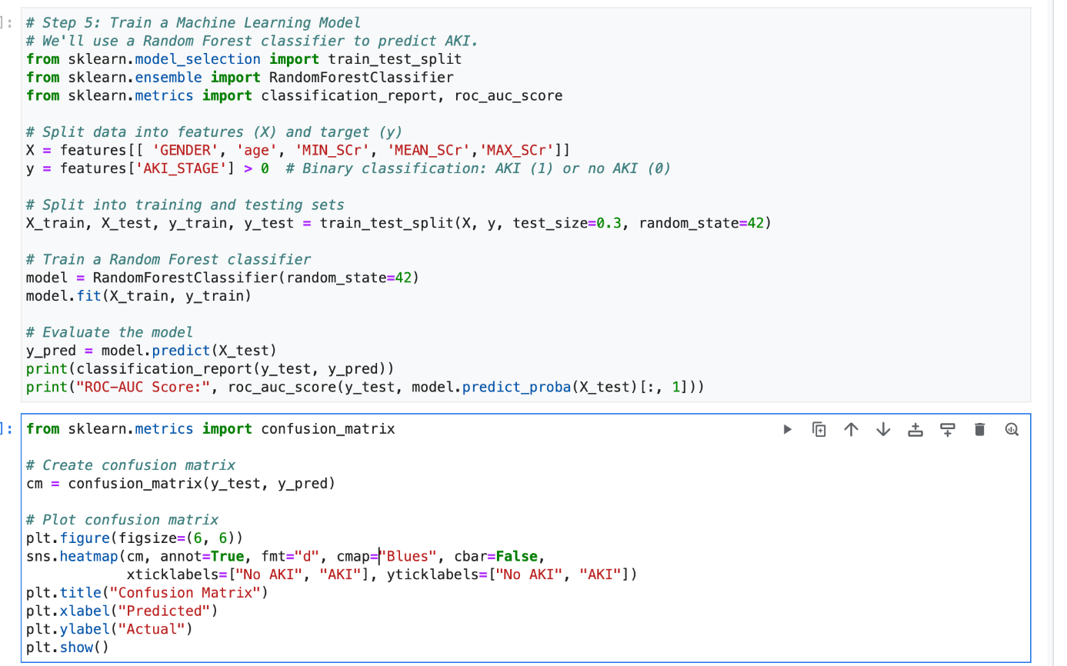
Step 5(a): Select and Train the Model
I trained a Random Forest classifier to predict the likelihood of Acute Kidney Injury (AKI) using the features GENDER, age and various SCr statistics. First, I split the dataset into training and testing sets. The model was trained on the training data and its performance was evaluated using classification metrics, including the classification report and ROC-AUC score. I also plotted a confusion matrix to visualize the model's predictions and the ROC curve to assess its discriminative ability.

Slide 14
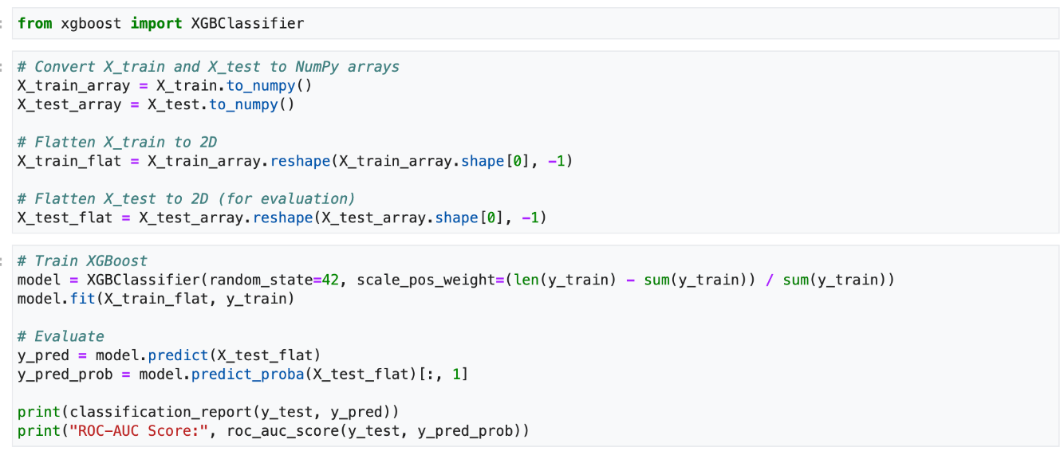
Step 5(b): Select and Train the Model
I trained an XGBoost classifier to predict Acute Kidney Injury (AKI), similar to the previous Random Forest model. First, I converted the training and testing sets into NumPy arrays and flattened the data into 2D arrays, which is required for XGBoost. I applied class imbalance handling by setting scale_pos_weight to the ratio of negative to positive samples in the training set. The model was trained on the flattened data, and I evaluated its performance using the classification report and ROC-AUC score.

Slide 15
Step 6: Evaluate the Model
The evaluation of the Random Forest model shows strong performance with an overall accuracy of 87%. The precision, recall and F1-score for both classes (AKI and non-AKI) are well-balanced, with values of 0.87, 0.90 and 0.88 for the False class (no AKI) and 0.88, 0.85 and 0.87 for the True class (AKI). The ROC-AUC score is 0.945, indicating excellent discriminative ability. The confusion matrix reveals 5230 true negatives, 605 false positives, 814 false negatives, and 4561 true positives, reflecting good classification performance, especially in identifying AKI cases.
The evaluation of the XGBoost model shows strong performance with an accuracy of 88%. The precision, recall, and F1-score for both classes (AKI and non-AKI) are well-balanced, with values of 0.87, 0.92 and 0.89 for the False class (no AKI) and 0.90, 0.85 and 0.88 for the True class (AKI). The ROC-AUC score is 0.955, indicating excellent discriminative ability. Overall, the XGBoost model provides slightly better performance compared to the Random Forest model, particularly in terms of precision for the True class (AKI).

Slide 16
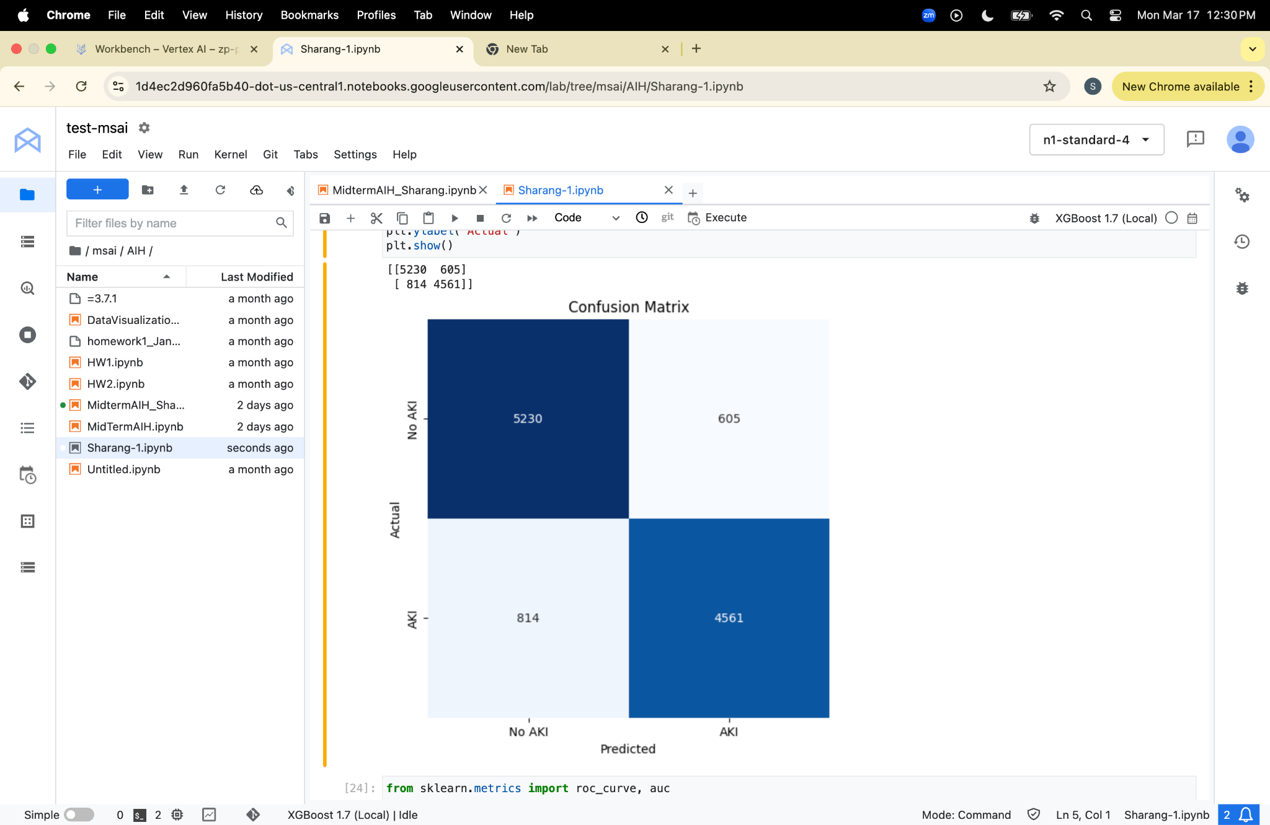
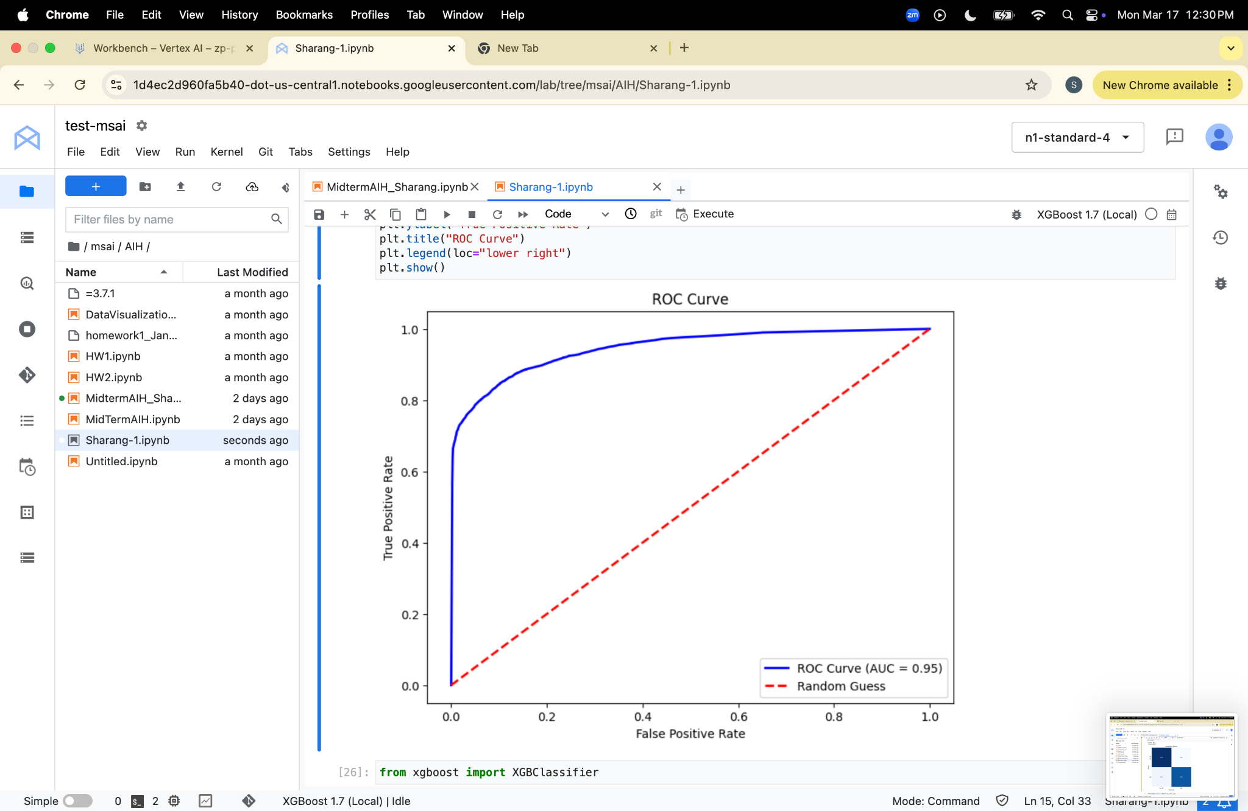

Confusion matrix and ROC-AUC curve
XGBoost
Random Forest

